Slide 1





US Car Sales Data Presentation

Slide 2
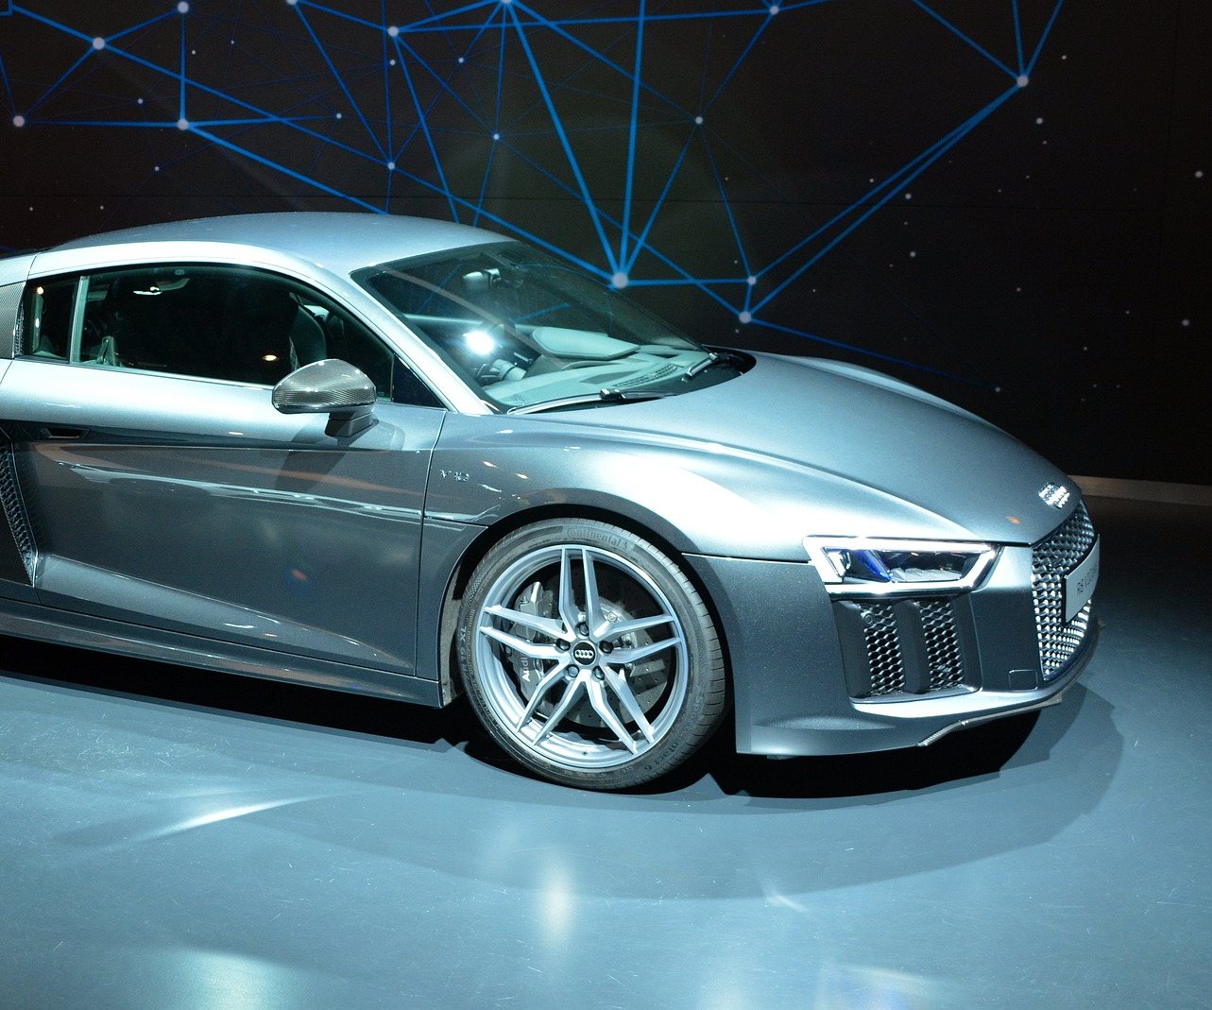
Presented by
Aaron Olson & Artur Dzhalalov
ICS-613 Introduction to Big Data Processing

Slide 3



Our Data Set
We wanted to know about used car sales

Slide 4
US Used Car Sales Data
“US used car sales data” used car dataset from Kaggle. This dataset was created by Kaggle contributor with username “tsaustin” a.k.a TS. Its final version was uploaded on November 16, 2020.

Slide 5
US Used Car Sales Data Stats
It is represented by a single file in csv format, and it is approximately 13 Mb in size. The single file contains 122145 rows representing car sales in the United States over a period of 20 months in 2019 and 2020.

Slide 6
Data Set Drawbacks
The aforementioned data set has a very low percentage of missing data for 9 columns out of 13 e.g., only 909 rows are missing zip code values, which means only 0.007% rows can be considered incomplete. However, four columns “trim”, “engine”, “body type”, and “drive type” are missing 40, 22, 17, 20 percent correspondingly.

Slide 7
US Used Car Sales Data Schema
Schema
"ID", (Primary key), "pricesold", "yearsold", "zipcode", "Mileage", "Make", "Model", "Year", "Trim", "Engine", "BodyType", "NumCylinders", "DriveType"

Slide 8
US Used Car Sales Data Examples
Example Rows
"137178","7500","2020","786**","84430","Ford","Mustang","1988","LX","5.0LGas V8","Sedan","0","RWD"
"96705","15000","2019","81006","0","Replica/Kit Makes","Jaguar Beck Lister","1958","","383 Fuel injected","Convertible","8","RWD"

Slide 9
Building the Data
cs = carSalesDF.select("ID","pricesold","yearsold","zipcode", find_state(carSalesDF.zipcode).alias("state"), "Mileage", "Make", "Model", "Year", "Trim", "Engine", "BodyType", "NumCylinders", "DriveType")
cs.registerTempTable("carSalesTable")

Slide 10
What did we ask and what did we learn?
Digging into the data

Slide 11
YoY Sales?
In what years were the most cars sold?
Were there big differences in the average prices of the cars sold between the years?

Slide 12
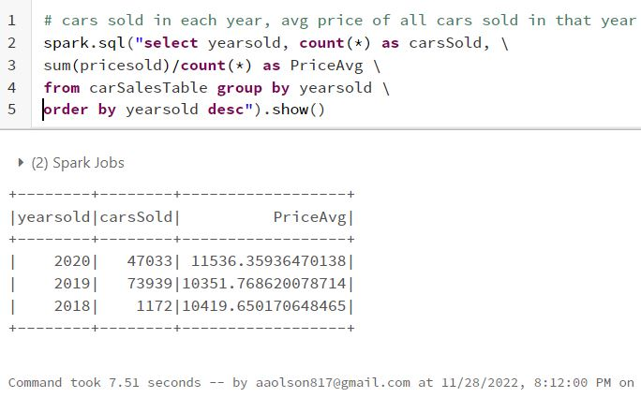
YoY Sales Results

Slide 13
YoY Sales Insight
Price Inflation is around 10% for 2019 - 2020
Overall sales volume may have slowed due to the increased prices

Slide 14
Most Expensive Cars?
What are the most expensive cars? Ranked from most expensive to least.

Slide 15
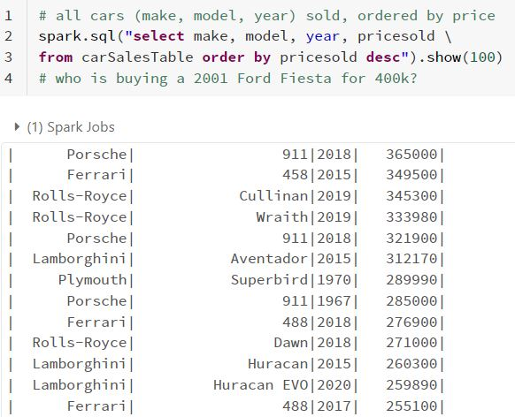
Most Expensive Cars Results

Slide 16
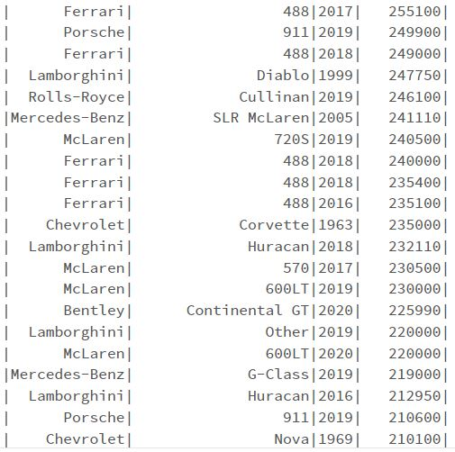
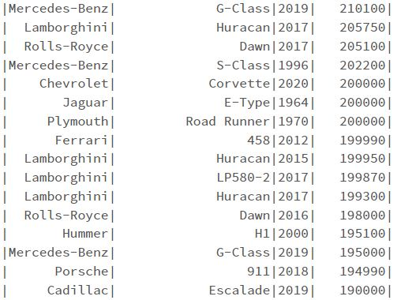
Most Expensive Cars Results Cont

Slide 17
Most Expensive Cars Insight
Sports cars and luxury cars (old and new) are the most expensive cars.
These cars seem to hold or increase their value over time.

Slide 18
Power Premium?
How much price difference is there between 4, 6 and 8 cylinder engine cars?
Is more engine power more expensive, and if so by how much?

Slide 19
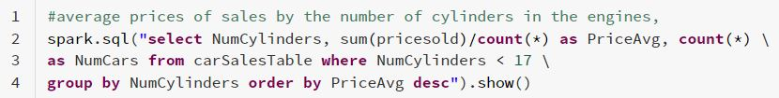
Power Premium Results

Slide 20
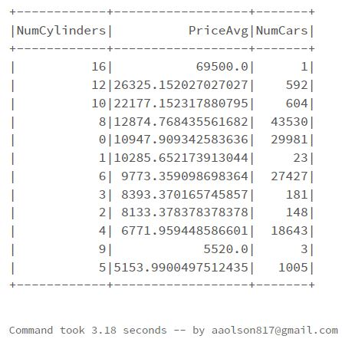
Power Premium Results Cont

Slide 21
Power Premium Insights
More power costs more
Significant increase from 8 -> 10 (~100%)
6 -> 8 is a good jump too (~25%)

Slide 22
Most Popular Body Type?
Most popular cars sold by vehicle type e.g., SUV, Sedan, Truck, etc ?
Valuable input for car sales teams which will help them to maintain their inventory more efficiently.

Slide 23
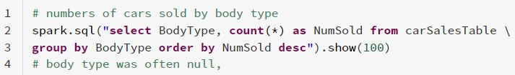
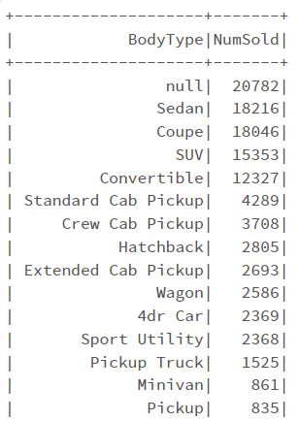
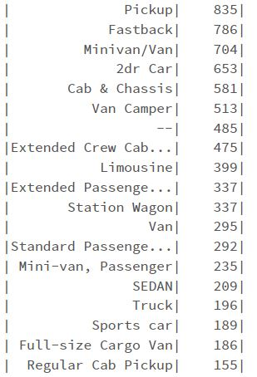
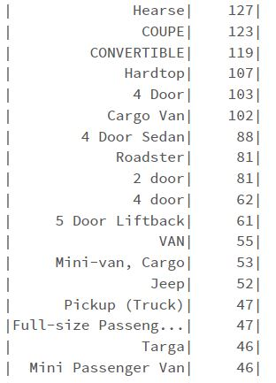
Most Popular Body Type Results

Slide 24
Most Popular Body Type Insights
Not listing the body type on the sale is fairly common
There are many non-standard body type descriptions
Sedans, Coupes, SUVs, Convertibles are very popular

Slide 25
Car Models by State?
Price of a same car model by the State?
This could be helpful for finding bargains.

Slide 26
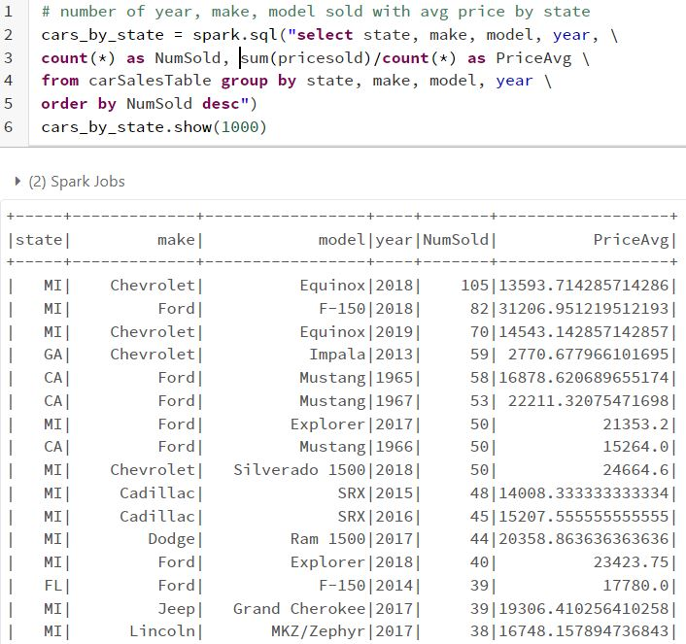
Car Models
by State Results
First look at the full dataset and make a new dataframe

Slide 27
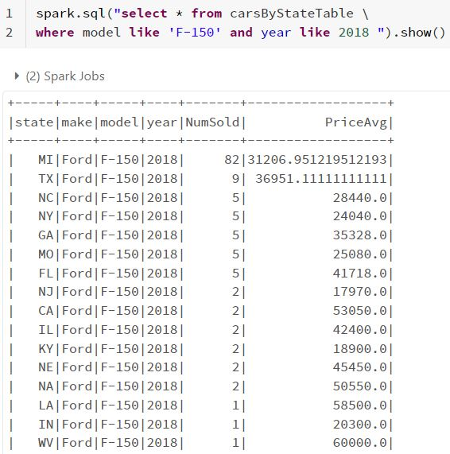
Car Models
by State Results cont
2018 Ford F-150

Slide 28
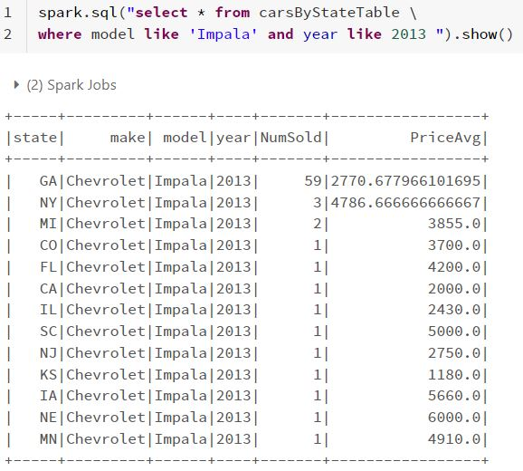
Car Models
by State Results cont
2013 Chevrolet Impala

Slide 29
Car Models by State Insights
Certain make/model/years seem to cluster heavily in certain states in this dataset

Slide 30
Cars Sold by State?
Number of cars sold by state and average price ?
Might indicate demographic information about financial well being of the country’s population by state.

Slide 31
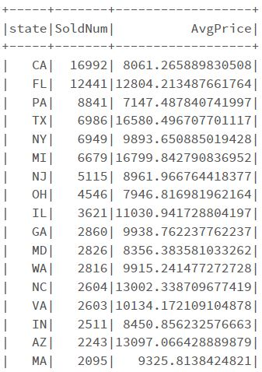
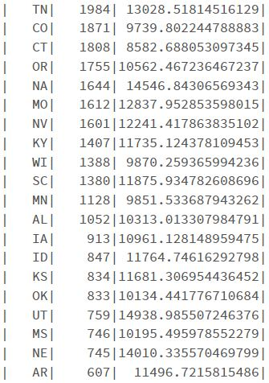
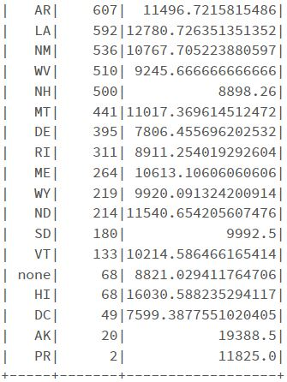
Cars Sold by State Results

Slide 32
Cars Sold by State Insights
Going from 1 state to another could result in a price delta of ~$5000
Given the results from the cars by state, going to certain states for certain models could be advantageous.

Slide 33
Most Popular Manufacturers by State?
Number of cars of the same manufacturer sold in each state?
What car manufacturer is the most preferred by state and nation wide?

Slide 34
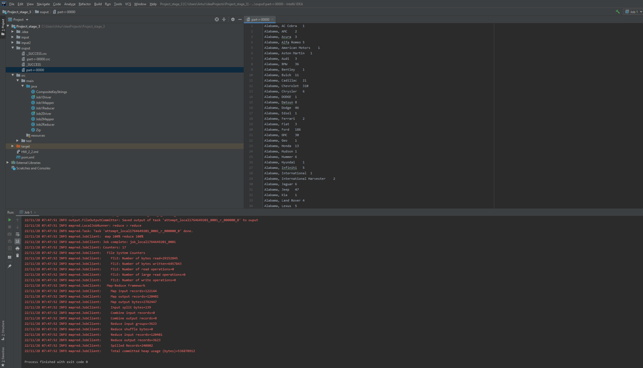
Most Popular Manufacturers by State Results

Slide 35
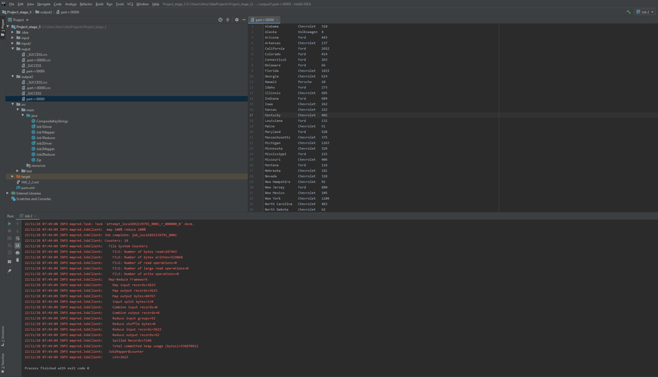
Most Popular Manufacturers by State Results cont

Slide 36
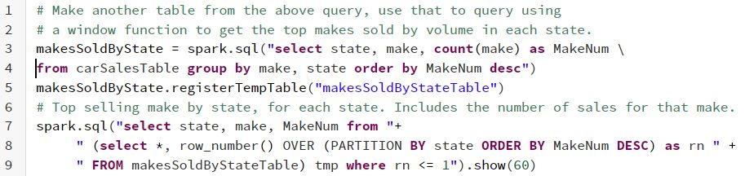
Most Popular Manufacturers by State Results cont

Slide 37
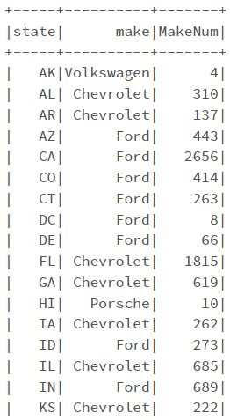
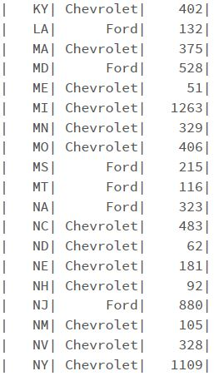
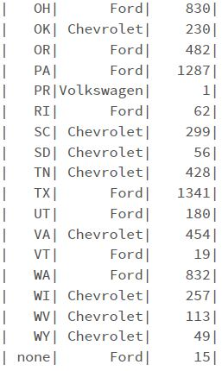
Most Popular Manufacturers by State Results cont

Slide 38
Who can Go the Distance?
What cars are still being sold on the market with the highest mileage ( by manufacturer) ?
What cars and what manufacturers have and produce the longest lasting engines?

Slide 39
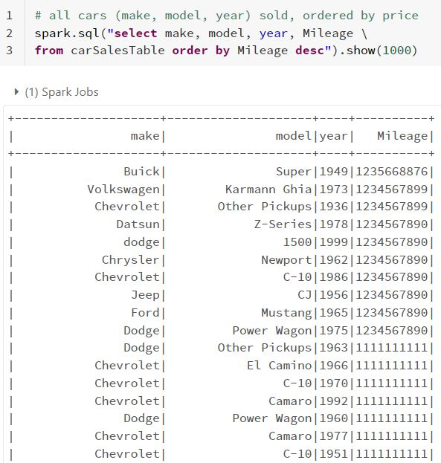
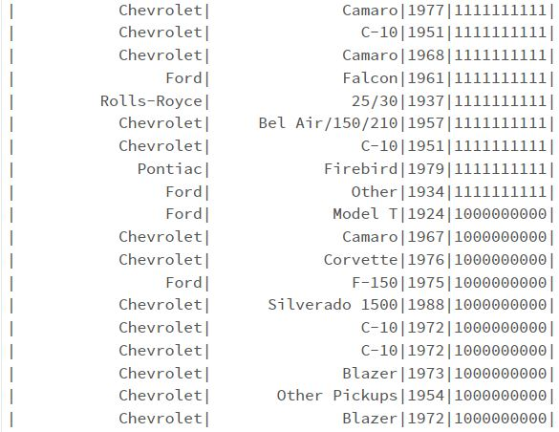
Who can Go the Distance Results

Slide 40
Who can Go the Distance Insights
The mileage data in this set was quite inaccurate
The answer to this question will remain a mystery

Slide 41
Overall Takeaways
Bad data (inaccurate) is often worse than missing data.
Car shopping between states could save a nice bit of money (assuming you could make transport make sense)
Sports cars could be good collectables

Slide 42
Appendix
Source Data
https://www.kaggle.com/datasets/tsaustin/us-used-car-sales-data
Source Code
https://github.com/aaronjolson/ICS-613-bigdata

Slide 43

Thank You!
Any questions?

Slide 44
1.
Transition headline
Let’s start with the first set of slides

Slide 45
Credits
Special thanks to all the people who made and released these awesome resources for free:
Presentation template by SlidesCarnival
Photographs by Unsplash

Slide 46
Presentation design
This presentation uses the following typographies:
Titles: Lexend Deca
Body copy: Muli light
Download for free at:
https://www.lexend.com/
https://www.fontsquirrel.com/fonts/muli
You don’t need to keep this slide in your presentation. It’s only here to serve you as a design guide if you need to create new slides or download the fonts to edit the presentation in PowerPoint®

